Slide 1



homies.
HOMIESAI.COM/SLIDES
LET’S GET THIS OVER WITH
Another presentation about AI?
I know. You’re already rolling your eyes.
THE UNCOMFORTABLE OPENING
01 / 60
Notes:
Open with the room’s likely reaction. Let the eye-roll land before promising this will not be another generic AI talk.
[Sources]
- User-provided speech brief.
- Original Homies-style illustration generated with OpenAI image generation, 2026-08-23.

Slide 2
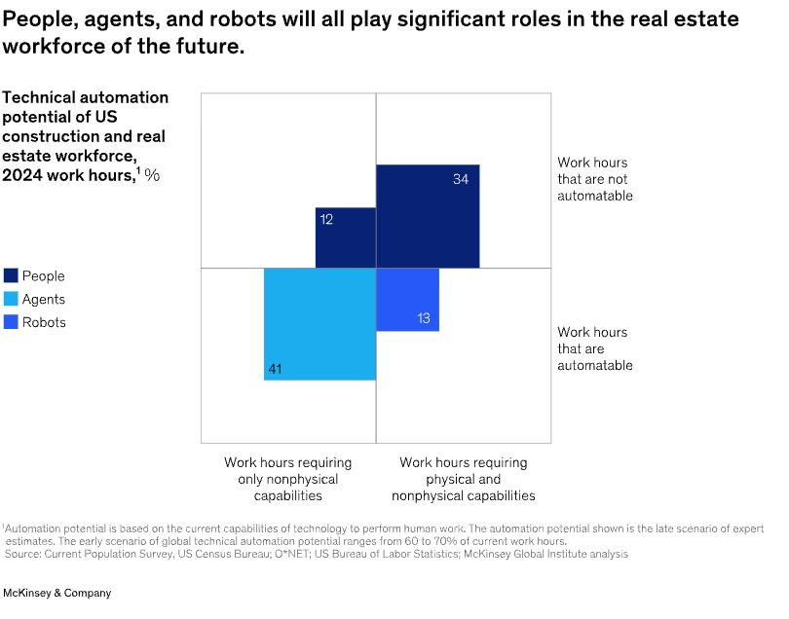
homies.
HOMIESAI.COM/SLIDES
MCKINSEY · MARCH 2026
AI can replace the weakest version of our job.
Across U.S. construction and real-estate work hours, 54% is technically automatable today.
46% human-only · 41% agents · 13% robots
Source scope: construction + real-estate workforce—not a realtor-role study.
THE STAKES
02 / 60
Notes:
The original McKinsey exhibit shows 46% of work hours as human-only and 54% automatable by agents or robots. Use it to argue that order-taking and information-shuttling are exposed; preserve the source scope verbally.
[Sources]
- McKinsey & Company, “How agentic AI can reshape real estate’s operating model,” March 4, 2026: https://www.mckinsey.com/industries/real-estate/our-insights/how-agentic-ai-can-reshape-real-estates-operating-model

Slide 3

homies.
HOMIESAI.COM/SLIDES
I’M GOING TO MOVE FAST
Don’t photograph every slide.
Scan once.
HOMIESAI.COM/SLIDES
Slides · sources · downloads
HOUSEKEEPING
03 / 60
Notes:
Invite the room to scan the QR code once. All slides, sources, and downloads are on the research page.
[Sources]
- Homies keynote access page: https://www.homiesai.com/research/limitless-ai-harness

Slide 4
homies.
HOMIESAI.COM/SLIDES
A CONCEPTUAL RACE
Raise the standard faster than AI can copy it.
The hedge is continuous improvement.
THE HEDGE
04 / 60
Notes:
Explain the hedge: AI will keep improving, but agents using AI can keep raising the definition of the role. The trajectories are illustrative, not forecasts.
[Sources]
- Conceptual illustration based on user-provided speech brief; not an empirical forecast.

Slide 5

homies.
HOMIESAI.COM/SLIDES
DANIEL FOCH
Canada’s #1 real estate podcast.
Events across Canada with CMHC. Thousands learning how to build multiplex housing.
WHO’S TALKING
05 / 60
Notes:
Quick credibility beat: podcast host and national event organizer. Keep moving.
[Sources]
- The Canadian Real Estate Investor on Apple Podcasts: https://podcasts.apple.com/ca/podcast/the-canadian-real-estate-investor/id1634197127
- User-provided speech brief for ranking and event claims.

Slide 6
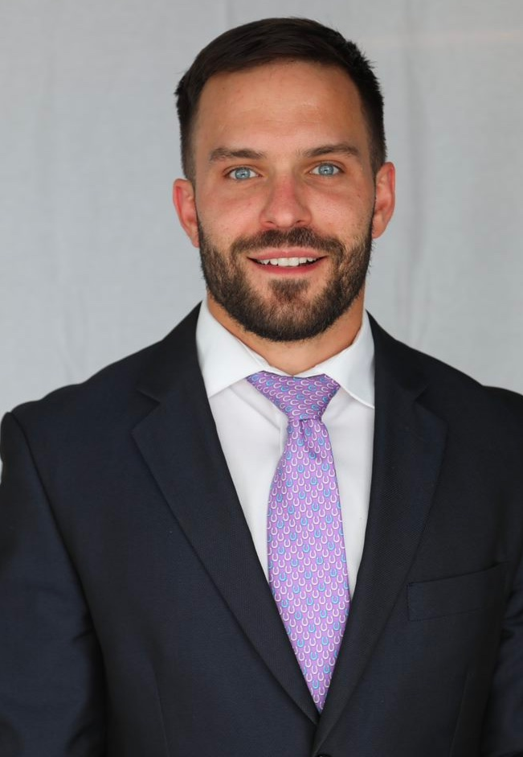
homies.
HOMIESAI.COM/SLIDES
STILL IN THE WORK
17 active listings. Every seller updated weekly.
2025
The most published realtor in Canada—appearing in WSJ, Bloomberg, Newsweek, Globe and Mail, Toronto Star, National Post, Financial Post, and HGTV.
WHO’S TALKING
06 / 60
Notes:
Establish that Daniel is an active realtor who uses systems to maintain service quality at volume. The publication list is audience-facing social proof.
[Sources]
- Daniel Foch headshot: https://www.homiesai.com/avatars/daniel-foch.jpg
- All listing, update, and publication claims are user-supplied.

Slide 7
homies.
HOMIESAI.COM/SLIDES
BUILT FOR AGENTS
The Habistat
H
licensed by the Toronto real estate board
The world’s most-used real-estate-board market analysis platform for realtors.
MARKET INTELLIGENCE
WHO’S TALKING
07 / 60
Notes:
Explain The Habistat as proof that Daniel has already built widely used realtor infrastructure.
[Sources]
- User-provided speech brief; platform-use and licensing claims not independently audited.

Slide 8

homies.
HOMIESAI.COM/SLIDES
FIVE YEARS OF BROKERAGE AI
We built AI inside Valery first.
A brokerage where the operating system improves the work behind every agent.
FOUNDING TEAM
WHO’S TALKING
08 / 60
Notes:
Introduce Valery as the original environment where the team built realtor AI systems.
[Sources]
- Valery: https://valery.ca/
- User-provided five-year timeline claim.

Slide 9

homies.
HOMIESAI.COM/SLIDES
THE QUESTION KEPT COMING
“Can we use your tools without switching brokerages?”
Yes.
That became Homies AI—the title sponsor of today’s event.
WHO’S TALKING
09 / 60
Notes:
Explain the product origin: brokerage agents outside Valery wanted the tools, so the team packaged the system as Homies.
[Sources]
- Homies: https://www.homiesai.com/
- User-provided title-sponsor claim.

Slide 10

homies.
HOMIESAI.COM/SLIDES
NEXT STOP
Ontario Home Builders’ Association
AI real-estate sales systems—presenting in a couple of days.
WHO’S TALKING
10 / 60
Notes:
One-slide credibility beat: upcoming OHBA talk on AI real-estate sales systems.
[Sources]
- OHBA official media kit: https://ohba.ca/web/home-builders/media/media-kit.aspx
- Event timing is user-supplied.

Slide 11
homies.
HOMIESAI.COM/SLIDES
OCTOBER 8
Invited to speak at the Government of Canada’s housing data conference.
🍁
Housing · Infrastructure · Data · Research
GOVERNMENT OF CANADA
WHO’S TALKING
11 / 60
Notes:
Credibility beat: the October 8 Government of Canada conference invitation. Plain text is used rather than the protected federal wordmark.
[Sources]
- User-provided invitation claim.
- Government of Canada official-symbol guidance: https://www.canada.ca/en/treasury-board-secretariat/services/government-communications/design-standard/official-symbols-design-standard-fip.html

Slide 12

homies.
HOMIESAI.COM/SLIDES
THE CREDENTIAL I CARE ABOUT MOST
Three kids. And time to be there.
The point of leverage isn’t more work. It’s more life.
WHY IT MATTERS
12 / 60
Notes:
Slow down. This is not a résumé flex. Daniel uses AI to preserve the most valuable time in his life and wants the room to identify what matters most to them.
[Sources]
- User-provided family context.
- Original Homies-style illustration generated with OpenAI image generation, 2026-08-23.

Slide 13
homies.
HOMIESAI.COM/SLIDES
SHOW OF HANDS
How many made this much gross last year?
$250K+
$500K+
AUDIENCE AUDIT
13 / 60
Notes:
Ask for hands at $250,000 gross, then $500,000 gross.
[Sources]
- User-provided speech brief, 2026-08-23.

Slide 14
homies.
HOMIESAI.COM/SLIDES
SHOW OF HANDS
Now the harder question: net?
$250K+
$500K+
AUDIENCE AUDIT
14 / 60
Notes:
Repeat the poll for net income. Let the drop in hands create tension.
[Sources]
- User-provided speech brief, 2026-08-23.

Slide 15
homies.
HOMIESAI.COM/SLIDES
SHOW OF HANDS
Who made more in 2025 than in 2021?
Less
More
AUDIENCE AUDIT
15 / 60
Notes:
Ask who made more in 2025 than in 2021. Do not editorialize yet.
[Sources]
- User-provided speech brief, 2026-08-23.

Slide 16

homies.
HOMIESAI.COM/SLIDES
SHOW OF HANDS
How many have read this one?
Buy Back Your Time
Dan Martell
AUDIENCE AUDIT
16 / 60
Notes:
Ask the room whether they have read Buy Back Your Time.
[Sources]
- Book-cover source: https://cdn1.fahasa.com/media/catalog/product/9/7/9780593422977.jpg

Slide 17

homies.
HOMIESAI.COM/SLIDES
SHOW OF HANDS
What about this one?
The Millionaire Real Estate Agent
Gary Keller, Dave Jenks & Jay Papasan
AUDIENCE AUDIT
17 / 60
Notes:
Ask the room whether they have read The Millionaire Real Estate Agent.
[Sources]
- Book-cover source: https://imagini.printrecarti.ro/images/products/originals/437/gary-keller-dave-jenks-jay-papasan-the-millionaire-real-estate-agent_436921.jpg

Slide 18

homies.
HOMIESAI.COM/SLIDES
SHOW OF HANDS
Or this one?
Rich Dad Poor Dad
Robert T. Kiyosaki
AUDIENCE AUDIT
18 / 60
Notes:
Ask the room whether they have read Rich Dad Poor Dad.
[Sources]
- Book-cover source: https://www.chirukaanuka.com/cdn/shop/products/Rich_Dad_Poor_Dad_English_Paperback_1_Feb_2008_grande.jpg

Slide 19

homies.
HOMIESAI.COM/SLIDES
SHOW OF HANDS
Harder one. Who’s read this?
The E-Myth Real Estate Agent
Michael E. Gerber & Brad Korn
AUDIENCE AUDIT
19 / 60
Notes:
Ask the room whether they have read The E-Myth Real Estate Agent.
[Sources]
- Book-cover source: https://hooquest.com/wp-content/uploads/2021/11/e-myth-real-estate-agent.jpg

Slide 20
homies.
HOMIESAI.COM/SLIDES
SHOW OF HANDS
Who personally wrote an offer this week?
I did
Delegated
AUDIENCE AUDIT
20 / 60
Notes:
Ask who wrote an offer, then emphasize personally wrote it.
[Sources]
- User-provided speech brief, 2026-08-23.

Slide 21
homies.
HOMIESAI.COM/SLIDES
SHOW OF HANDS
Who personally put in a listing this week?
I did
Admin / VA
AUDIENCE AUDIT
21 / 60
Notes:
Ask who submitted a listing. Tell the room to lower hands if an admin, VA, or teammate executed it.
[Sources]
- User-provided speech brief, 2026-08-23.

Slide 22
homies.
HOMIESAI.COM/SLIDES
SHOW OF HANDS
Who personally booked showings this week?
I did
System / team
AUDIENCE AUDIT
22 / 60
Notes:
Ask who booked showings and who personally executed the task.
[Sources]
- User-provided speech brief, 2026-08-23.

Slide 23
homies.
HOMIESAI.COM/SLIDES
You read the leverage books… then did the $20/hour work.
FOUR BOOKS · ONE ROOM
THE CONTRADICTION
23 / 60
Notes:
Bring the four covers together. The same people who read them raised their hands for offer writing, listing entry, and showing coordination.
[Sources]
- Book-cover source: https://cdn1.fahasa.com/media/catalog/product/9/7/9780593422977.jpg
- Book-cover source: https://imagini.printrecarti.ro/images/products/originals/437/gary-keller-dave-jenks-jay-papasan-the-millionaire-real-estate-agent_436921.jpg
- Book-cover source: https://www.chirukaanuka.com/cdn/shop/products/Rich_Dad_Poor_Dad_English_Paperback_1_Feb_2008_grande.jpg
- Book-cover source: https://hooquest.com/wp-content/uploads/2021/11/e-myth-real-estate-agent.jpg

Slide 24
homies.
HOMIESAI.COM/SLIDES
ZOOM IN
What do all four books have in common?
They teach leverage.
THE CONTRADICTION
24 / 60
Notes:
Pause and invite answers before revealing the shared principle: leverage.
[Sources]
- User-provided framing of the four books.

Slide 25
homies.
HOMIESAI.COM/SLIDES
THE MATH IS BRUTAL
Your time will never be worth $1,000, $2,000, or $10,000 per hour…
…if you keep doing $20/hour work.
THE LEVERAGE LESSON
25 / 60
Notes:
State the core economic contradiction cleanly.
[Sources]
- User-provided speech brief, 2026-08-23.

Slide 26
homies.
HOMIESAI.COM/SLIDES
BUY BACK YOUR TIME
If someone can do it below your target hourly value, buy it back.
Time is the scarce asset.
THE LEVERAGE LESSON
26 / 60
Notes:
Summarize the book’s core principle in the context of delegation.
[Sources]
- Book-cover source: https://cdn1.fahasa.com/media/catalog/product/9/7/9780593422977.jpg

Slide 27
homies.
HOMIESAI.COM/SLIDES
RICH DAD POOR DAD · CASHFLOW QUADRANT
Escape trading time for money.
E
S
Employee
Self-employed
B
I
Business owner
Investor
THE LEVERAGE LESSON
27 / 60
Notes:
Use Kiyosaki’s Cashflow Quadrant to contrast self-employment with business ownership and investing. The point is to stop selling hours one at a time.
[Sources]
- Book-cover source: https://www.chirukaanuka.com/cdn/shop/products/Rich_Dad_Poor_Dad_English_Paperback_1_Feb_2008_grande.jpg

Slide 28
homies.
HOMIESAI.COM/SLIDES
THE MILLIONAIRE REAL ESTATE AGENT
Hire an admin. Delegate the work away.
Your highest-value work needs room.
THE LEVERAGE LESSON
28 / 60
Notes:
Summarize the MREA delegation lesson.
[Sources]
- Book-cover source: https://imagini.printrecarti.ro/images/products/originals/437/gary-keller-dave-jenks-jay-papasan-the-millionaire-real-estate-agent_436921.jpg

Slide 29
homies.
HOMIESAI.COM/SLIDES
THE E-MYTH
Work on the business—not inside every task.
Own the system, not the job.
THE LEVERAGE LESSON
29 / 60
Notes:
Summarize the E-Myth systemization lesson.
[Sources]
- Book-cover source: https://hooquest.com/wp-content/uploads/2021/11/e-myth-real-estate-agent.jpg

Slide 30
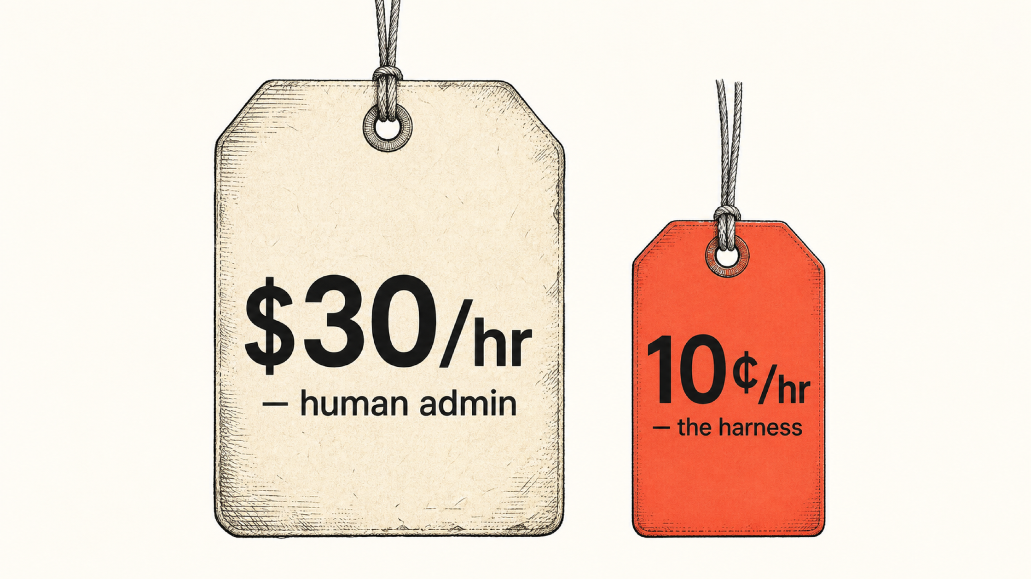
homies.
HOMIESAI.COM/SLIDES
THE UPDATED MATH
$20/hour work is now 20¢/hour work.
So why are you still doing it?
THE LEVERAGE LESSON
30 / 60
Notes:
Return to the hourly-value slide with the AI update. The illustration is a teaching metaphor, not a literal cost study.
[Sources]
- User-provided speech brief.
- Homies illustration asset from the existing Harness keynote, accessed at https://www.homiesai.com/research/keynote/11-price-of-leverage.png

Slide 31
homies.
HOMIESAI.COM/SLIDES
IF I DO ONE THING TODAY
I want to give you tomorrow back.
Automate the work you hate—immediately.
Walk your AI through the process once. Let the system execute it next time.
THE PROMISE
31 / 60
Notes:
Set the outcome for the tactical section: tomorrow, the audience should stop doing one low-value task they hate.
[Sources]
- User-provided speech brief, 2026-08-23.

Slide 32
homies.
HOMIESAI.COM/SLIDES
THIS IS AN AI HARNESS
The model is 2%. The system is everything else.
100%
Pick the horse. Then build the harness around it.
BUILD THE HARNESS
32 / 60
Notes:
Reveal the completed teaching model first. The seven weights sum to 100% and represent build effort, not a scientific measurement.
[Sources]
- User-provided harness framework; percentage allocations normalized into a 100% teaching model.

Slide 33
homies.
HOMIESAI.COM/SLIDES
HARNESS 1 OF 7
Stop chasing models.
2%
They’re all good enough for this work. Pick one and stick to it.
BUILD THE HARNESS
33 / 60
Notes:
Choose a frontier model and move on. Real-estate work is hard but not usually complicated enough to justify constant model-hopping.
[Sources]
- User-provided speech brief, 2026-08-23.

Slide 34
homies.
HOMIESAI.COM/SLIDES
HARNESS 2 OF 7
Install the harness app.
2%
Put it on your actual computer: ChatGPT, Claude, Grok, OpenClaw, Hermes—or Homies.
BUILD THE HARNESS
34 / 60
Notes:
Install a work app, not just a browser tab. Advanced model-swapping is useful but technically difficult and not the core value.
[Sources]
- User-provided speech brief, 2026-08-23.

Slide 35

homies.
HOMIESAI.COM/SLIDES
YOLO
10 free spots. One year of Homies.
First 10 to sign up.
HOMIESAI.COM/START
CHATGPT SUBSCRIPTIONS CAN PLUG IN
LIVE GIVEAWAY
35 / 60
Notes:
Live giveaway beat: the first ten signups receive one free year. If the offer terms change, update this slide before the event.
[Sources]
- User-provided giveaway offer and terms.
- Signup destination: https://www.homiesai.com/start

Slide 36
homies.
HOMIESAI.COM/SLIDES
HARNESS 3 OF 7
Connect it to your business.
3%
Email · CRM · contacts · files · social · authorized MLS / IDX.
BUILD THE HARNESS
36 / 60
Notes:
Before connecting systems, disable model training on business data where the platform provides that setting. Use authorized APIs. Do not dump MLS data or client contacts into an unapproved AI workflow.
[Sources]
- User-provided privacy/compliance guidance; not legal advice.
- McKinsey article emphasizes action layers, permissions, approvals, and governance: https://www.mckinsey.com/industries/real-estate/our-insights/how-agentic-ai-can-reshape-real-estates-operating-model

Slide 37
homies.
HOMIESAI.COM/SLIDES
THE SIMPLEST INTEGRATION TUTORIAL
Google:
[your product] + API
Then ask your AI to connect it.
BUILD THE HARNESS
37 / 60
Notes:
Make integration feel concrete: search for the product API, then use the AI to help connect it. Permissions and vendor terms still apply.
[Sources]
- User-provided workflow advice.

Slide 38
homies.
HOMIESAI.COM/SLIDES
HARNESS 4 OF 7
Give it memory.
8%
Past email · CRM history · call notes · transcripts · Notion · client context.
BUILD THE HARNESS
38 / 60
Notes:
A memory system lets the harness learn how the agent communicates and serves clients. Use consented, authorized sources and minimize data access.
[Sources]
- User-provided speech brief, 2026-08-23.

Slide 39
homies.
HOMIESAI.COM/SLIDES
HARNESS 5 OF 7
Train it how you work.
70%
This is the hard part: examples, SOPs, exceptions, review standards, and feedback.
BUILD THE HARNESS
39 / 60
Notes:
Training is the majority of the effort. Treat it like onboarding an admin—except the system can retain the documented process.
[Sources]
- User-provided speech brief, 2026-08-23.

Slide 40
homies.
HOMIESAI.COM/SLIDES
HARNESS 6 OF 7
Add channels.
5%
Remote dispatch · phone · CRM number · webhook · mobile app.
BUILD THE HARNESS
40 / 60
Notes:
Make the harness reachable where the work arrives. Use narrow permissions and review gates for consequential actions.
[Sources]
- User-provided speech brief, 2026-08-23.

Slide 41
homies.
HOMIESAI.COM/SLIDES
HARNESS 7 OF 7
Keep it always on.
10%
Mac mini at home—or a secure cloud service that stays alive when your laptop closes.
BUILD THE HARNESS
41 / 60
Notes:
The system needs persistent, secure hosting. Homies uses a cloud model so the agent can work from phone or web without a local session shutting down.
[Sources]
- User-provided speech brief, 2026-08-23.

Slide 42
homies.
HOMIESAI.COM/SLIDES
IF THIS SOUNDS HARD
That’s because it is.
But every person in this room can do it.
DIY teaches you something. It just may not be the highest-value use of your time.
BUILD VERSUS BUY
42 / 60
Notes:
Acknowledge the complexity and reassure the audience that they can build it. Then transition to the opportunity cost of DIY.
[Sources]
- User-provided speech brief, 2026-08-23.

Slide 43

homies.
HOMIESAI.COM/SLIDES
JUST BECAUSE YOU CAN…
Don’t become a hobby software developer.
The market is slow. Your CRM still needs follow-up.
BUILD VERSUS BUY
43 / 60
Notes:
Use the renovation analogy: Daniel can install flooring and trim, but hiring an expert is a better trade when his time is more valuable elsewhere.
[Sources]
- User-provided renovation analogy.
- Original Homies-style illustration generated with OpenAI image generation, 2026-08-23.

Slide 44

homies.
HOMIESAI.COM/SLIDES
THE PRINCIPLE OF COMPOUNDING
Your relationship with AI compounds.
01
Investments
02
Knowledge
03
Trust
04
Going to the gym
BUILD VERSUS BUY
44 / 60
Notes:
AI improves through repeated use: the agent learns the system, and the system learns the agent. Start with real work, not novelty prompts.
[Sources]
- User-provided compounding examples.
- Homies illustration asset from the existing Harness keynote: https://www.homiesai.com/research/keynote/13-staircase.png

Slide 45
homies.
HOMIESAI.COM/SLIDES
YOU CAN BUILD IT YOURSELF
The question is whether it’s worth your time.
I spent ~80 hours. I wouldn’t do it again.
BUILD VERSUS BUY
45 / 60
Notes:
Close the DIY teaching section: building is possible, but Daniel would not repeat the 80-hour process given today’s out-of-the-box options.
[Sources]
- User-provided 80-hour estimate.

Slide 46
homies.
HOMIESAI.COM/SLIDES
BUILT FOR REALTORS
Hit fast-forward.
THE REALTOR AI HARNESS
A customized AI harness for real estate.
CRM
EMAIL
FILES
SOPs
Five years of brokerage AI—packaged, connected, trained, and always on.
MEMORY
ALWAYS-ON
5 YEARS → 5 MINUTES
FAST-FORWARD
46 / 60
Notes:
Introduce Homies as the fast-forward option: a prebuilt, realtor-specific harness.
[Sources]
- Homies: https://www.homiesai.com/

Slide 47

homies.
HOMIESAI.COM/SLIDES
JANUARY’S FIRST VERSION
Admittedly… too powerful.
A little “monkey with a machine gun.”
THE BETA
47 / 60
Notes:
Use the safe comedic metaphor for the first OpenClaw-based realtor harness: powerful, but too unconstrained for a mainstream product.
[Sources]
- User-provided product-history claim and metaphor.
- Original Homies-style illustration generated with OpenAI image generation, 2026-08-23.

Slide 48
homies.
HOMIESAI.COM/SLIDES
MAY → TODAY
Beta testing is complete.
BETA
COMPLETE
200+
$50 / month
paying agents
daily product testing
THE BETA
48 / 60
Notes:
State that the simplified harness has been tested daily with more than 200 paying agents at $50/month and is now out of beta.
[Sources]
- All beta counts, timing, and pricing are user-supplied and not independently audited.

Slide 49
homies.
HOMIESAI.COM/SLIDES
REAL WORK COMPLETED
The harness has been busy.
500+
2,200
27,051
374
offers written
showings booked
CRM contacts made
social posts
7,895
186
345
73
emails sent
home evaluations
seller reports
ad funnels
5,700
47,943
200+
11 hrs
leads generated
follow-ups diarized
paying agents
saved weekly
THE BETA
49 / 60
Notes:
Run through the platform activity briskly. The slide preserves every user-provided metric in a scan-friendly format.
[Sources]
- All platform-activity metrics are user-supplied and not independently audited.

Slide 50
homies.
HOMIESAI.COM/SLIDES
THANK-YOU PRICING
$50/month. Locked in for life.
The same founder price we offered our beta testers.
FOUNDER PRICING
We lose money at this price.
HOMIESAI.COM/START
THE OFFER
50 / 60
Notes:
Present the founder-price offer without high pressure. The claim that the company loses money at this price is user-supplied.
[Sources]
- Offer destination: https://www.homiesai.com/start
- All pricing and economics claims are user-supplied.

Slide 51
homies.
HOMIESAI.COM/SLIDES
WHAT BETA USERS TOLD US
11
hours saved every week
SAVE THE HOURS
Without the ~80-hour DIY build and training process.
HOMIESAI.COM/START
THE OFFER
51 / 60
Notes:
State the reported average: approximately 11 hours saved per week. Contrast with Daniel’s estimated 80-hour DIY build.
[Sources]
- Both the 11-hour average and 80-hour estimate are user-supplied and not independently audited.
- Offer destination: https://www.homiesai.com/start

Slide 52
homies.
HOMIESAI.COM/SLIDES
11 HOURS PER WEEK
What would you do with it?
Time is the product.
GET YOUR WEEK BACK
HOMIESAI.COM/START
TIME RETURNED
52 / 60
Notes:
Transition from the product to the human payoff. Keep the start QR fixed in place through the remaining slides.
[Sources]
- Offer destination: https://www.homiesai.com/start

Slide 53
homies.
HOMIESAI.COM/SLIDES
11 HOURS →
Prospecting that actually grows the business.
MON
TUE
WED
THU
FRI
MORE SELLING TIME
FOLLOW
UP
FOLLOW
UP
FOLLOW
UP
OPEN
OPEN
HOMIESAI.COM/START
TIME RETURNED
53 / 60
Notes:
First example from beta users: reinvesting saved time in prospecting and follow-up.
[Sources]
- User-provided beta-user activity examples.
- Offer destination: https://www.homiesai.com/start

Slide 54

homies.
HOMIESAI.COM/SLIDES
11 HOURS →
Go for the jet-ski ride.
Your life doesn’t need to wait for retirement.
GET YOUR WEEK BACK
HOMIESAI.COM/START
TIME RETURNED
54 / 60
Notes:
Second example: leisure now, not someday.
[Sources]
- User-provided beta-user activity examples.
- Original Homies-style illustration generated with OpenAI image generation, 2026-08-23.
- Offer destination: https://www.homiesai.com/start

Slide 55

homies.
HOMIESAI.COM/SLIDES
11 HOURS →
Read. Learn. Operate better.
INVEST IN YOURSELF
HOMIESAI.COM/START
TIME RETURNED
55 / 60
Notes:
Third example: invest the time in learning to operate and grow the business.
[Sources]
- User-provided beta-user activity examples.
- Homies illustration asset from the existing Harness keynote: https://www.homiesai.com/research/keynote/10-bookshelf.png
- Offer destination: https://www.homiesai.com/start

Slide 56
homies.
HOMIESAI.COM/SLIDES
11 HOURS →
Travel without the business going dark.
WORK CAN KEEP MOVING
YYZ
→
ANYWHERE
HOMIESAI.COM/START
TIME RETURNED
56 / 60
Notes:
Fourth example: travel while the harness keeps the routine work moving.
[Sources]
- User-provided beta-user activity examples.
- Offer destination: https://www.homiesai.com/start

Slide 57

homies.
HOMIESAI.COM/SLIDES
11 HOURS →
Better relationships with clients.
Automate the friction—not the relationship.
MORE CLIENT TIME
HOMIESAI.COM/START
TIME RETURNED
57 / 60
Notes:
Fifth example: use the time to create more present, higher-trust client relationships.
[Sources]
- User-provided beta-user activity examples.
- Original Homies-style illustration generated with OpenAI image generation, 2026-08-23.
- Offer destination: https://www.homiesai.com/start

Slide 58
homies.
HOMIESAI.COM/SLIDES
11 HOURS →
More time with your kids.
They’re only young once.
GET THE TIME BACK
HOMIESAI.COM/START
TIME RETURNED
58 / 60
Notes:
Final example: family time. Slow down and connect this back to Daniel’s opening credibility story.
[Sources]
- User-provided family context and beta-user activity examples.
- Original Homies-style illustration generated with OpenAI image generation, 2026-08-23.
- Offer destination: https://www.homiesai.com/start

Slide 59
homies.
HOMIESAI.COM/SLIDES
THE WHOLE POINT
That’s what this is all about.
11 hours of your life—returned every week.
GET YOUR WEEK BACK
HOMIESAI.COM/START
THE POINT
59 / 60
Notes:
Resolve the product story in human terms: the product is time returned.
[Sources]
- User-provided 11-hours-per-week claim.
- Offer destination: https://www.homiesai.com/start

Slide 60
homies.
HOMIESAI.COM/SLIDES
FOUR BOOKS · ONE DECISION
Buy back your time.
01
Work on the business.
02
Stop trading time for money.
READY WHEN YOU ARE
03
Become the millionaire real estate agent.
Thank you.
HOMIESAI.COM/START
THANK YOU
60 / 60
Notes:
Return to the four books and resolve each one in the product’s human outcome. Thank the audience.
[Sources]
- Book-cover source: https://cdn1.fahasa.com/media/catalog/product/9/7/9780593422977.jpg
- Book-cover source: https://imagini.printrecarti.ro/images/products/originals/437/gary-keller-dave-jenks-jay-papasan-the-millionaire-real-estate-agent_436921.jpg
- Book-cover source: https://www.chirukaanuka.com/cdn/shop/products/Rich_Dad_Poor_Dad_English_Paperback_1_Feb_2008_grande.jpg
- Book-cover source: https://hooquest.com/wp-content/uploads/2021/11/e-myth-real-estate-agent.jpg
- Offer destination: https://www.homiesai.com/start

